Slide 1





By BIPUL KUMAR
(25th Aug Batch)
Hospital Management System Analytics
Key Insights & Performance Metrics

Slide 2
Executive Summary
KEY HIGHLIGHT:
A significant portion of appointments are from one-time patients, and there are opportunities to increase overall doctor utilization and reduce appointment cancellations.
Top 3 Actionable Insights:
Implement a system to balance patient load across doctors.
Enhance communication to reduce appointment cancellation rates.
Optimize scheduling for peak booking hours.

Slide 3
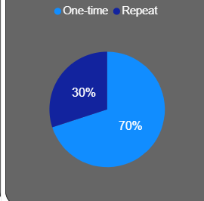
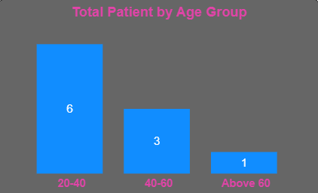
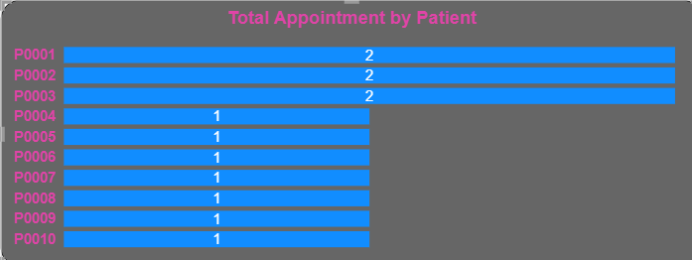
Patient Analytics
Understanding patient behavior is crucial for strategic growth. Our analysis focuses on patient loyalty and demographics.
Repeat vs. One-time Patients: We observe a high volume of one-time patients, indicating a need for strategies to improve patient retention and convert them into repeat visitors.
Top Patients by Visits: A small group of highly frequent patients contribute a substantial portion of the total appointments.
Age Group Segmentation: Appointments are concentrated in the 30-40 age group, with significant demand from the Under 18 and 18-30 segments.

Slide 4
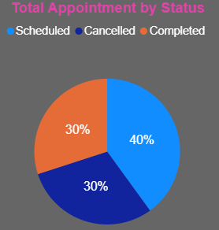
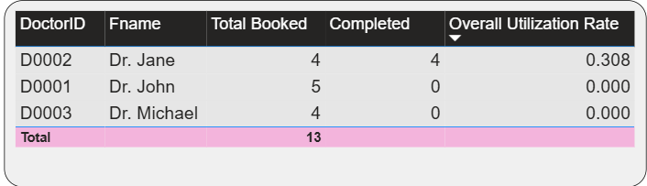
Doctor Performance
Assessing doctor performance metrics allows for equitable workload distribution and performance improvement.
Total Appointments: Analysis shows a significant variance in total appointments per doctor.
Completed vs. Cancelled vs. Scheduled: A notable percentage of appointments are cancelled, impacting overall efficiency and resource planning.
Doctor Utilization Rate: The ratio of completed appointments to booked appointments varies, highlighting underutilized and over-utilized doctors.
Average Appointments per Day: Our data shows that the average appointments per day per doctor is significantly below the assumed capacity of eight, indicating potential for increased efficiency.

Slide 5
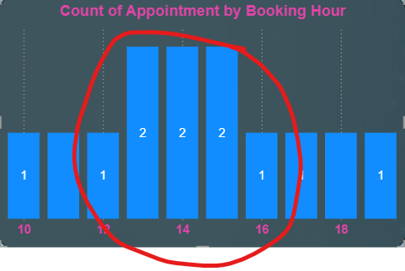
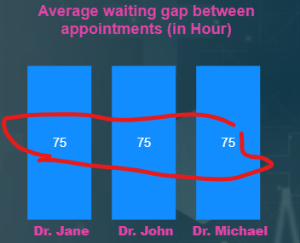
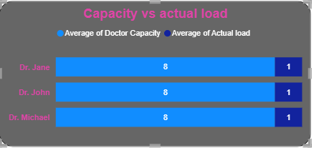
Operational Insights
Optimizing the appointment system requires understanding the dynamics of booking and scheduling.
Peak Booking Hours: Appointment demand is highest during specific hours, creating potential bottlenecks.
Average Waiting Gap: The average time between appointments for a doctor shows opportunities to streamline scheduling and reduce idle time.
Capacity vs. Actual Load: Based on an assumption of eight appointments per day per doctor, there is a considerable gap between theoretical capacity and actual completed appointments.

Slide 6
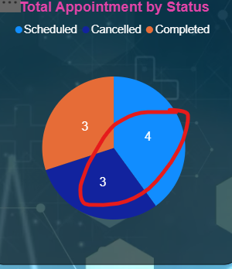
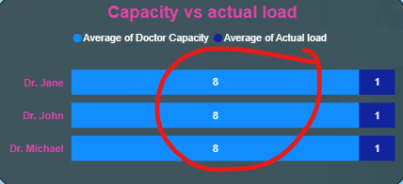
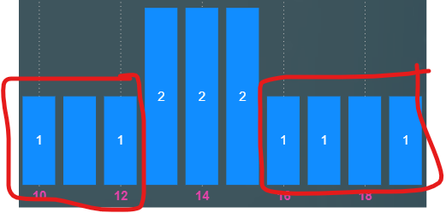
Recommendations
Based on the key insights, we propose the following data-driven recommendations.
Balance Patient Load: Use data to intelligently allocate new appointments, ensuring no single doctor is overwhelmed while others are underutilized.
Reduce Cancellations: Implement automated appointment reminders via SMS or email to decrease the cancellation rate.
Optimize Peak Hours: Use data on peak booking times to adjust staffing and resource availability, maximizing throughput.
Expand Capacity: For high-demand doctors, consider adding additional appointment slots or reallocating resources to meet patient needs.

Slide 7

THANK
YOU

